Slide 1


Garbage classification

Slide 2



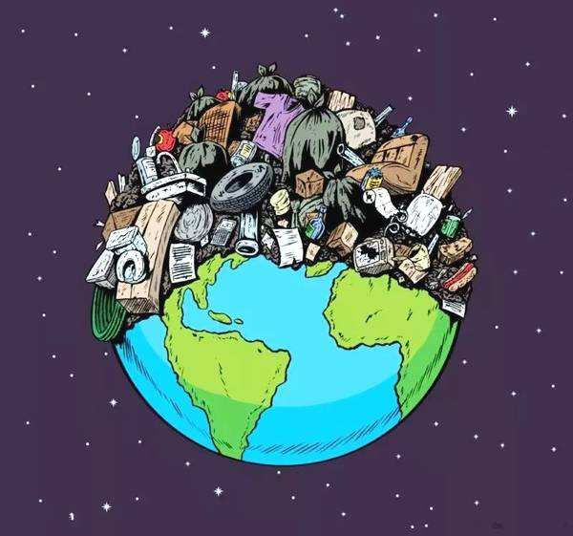
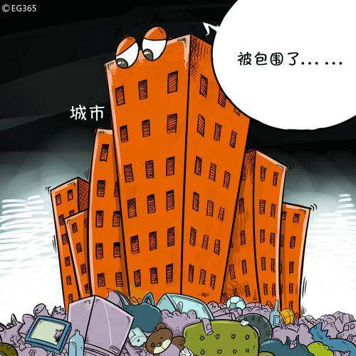
Garbage classification

Slide 3





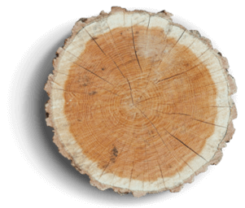



Garbage classification
Our user-friendly and functional search engine helps you locate the right templates, effectively saving your time.
Recyclable garbage
Hazardous garbage
paper, metal, plastic,
glass and so on
used batteries and expired drugs.
NATURE
Kitchen waste
Other garbage
leftovers, bones and other food wastes

